Slide 1

CENTRALISED CIRCULAR
ECONOMY-Waste Management
MATHEMATICS FOR INTELLIGENT SYSTEMS (23MAT112)
INTRODUCTION TO DATA STRUCTURES & ALGORITHMS (24AIM111)
Harithra S. – CB.AI.U4AIM24013
Harshath A. – CB.AI.U4AIM24015
N S Tharika. – CB.AI.U4AIM24027
RA Thanushika Sri. – CB.AI.U4AIM24034
GROUP 12

Slide 2
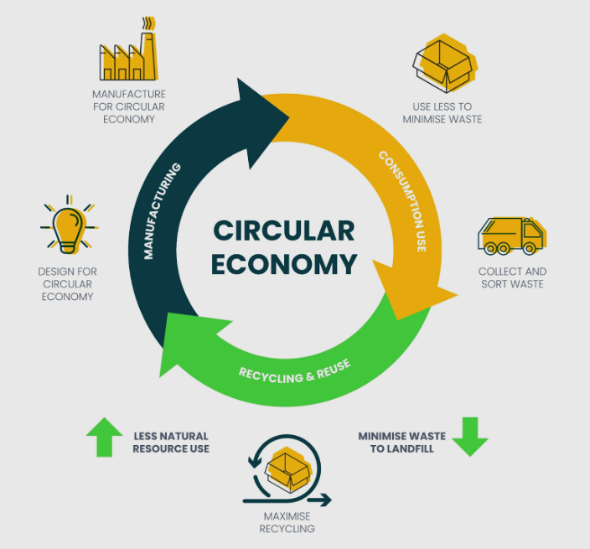
INTRODUCTION
The centralised circular economy project connects waste collectors,recycling plants and shops through a streamlined platform for managing wastes.
The system is centralized because all data and operations are managed through a single platform.
The system integrates efficient data structures, algorithms, and mathematical models to optimize operations, ensure secure transactions, and provide real-time updates.
This platform promotes sustainability and enhances the efficiency of waste management.
2

Slide 3
PROBLEM STATEMENT
Waste mismanagement is a growing environmental and economic concern worldwide. Traditional waste collection and recycling systems are often fragmented and inefficient leading to:
Lack of motive for individuals and businesses to participate in recycling.
Disconnected stakeholders (collectors, recycling plants, and shops) causing delays and inefficiencies
3

Slide 4
OBJECTIVES
● Promote a Sustainable Circular Economy: Reduce waste and maximize the reuse of materials, reducing environmental impact.
● Notified and Responsive System : Ensure Interaction by Providing Instant Notifications and Enabling Quick User Actions
● Role-Based User Access and Interaction: Adapts based on user roles ensuring easy access to relevant data and can make decisions that align with their responsibilities. Different users will have dashboards customized for their needs.
4

Slide 5
LITERATURE REVIEW
REFERENCE | STUDY | OBJECTIVE | METHODOLOGY | KEY FINDINGS | LIMITATIONS
[1] | Hemidat, S.; Achouri, O.; El Fels, L.; Elagroudy, S.; Hafidi, M.; Chaouki, B.; Ahmed, M.; Hodgkinson, I.; Guo, J. Solid Waste Management in the Context of a Circular Economy in the MENA Region. Sustainability 2022, | To analyze waste management strategies within the circular economy framework in the MENA region, emphasizing sustainable recycling. | The paper adopts a qualitative approach, reviewing existing policies, infrastructure, and technological practices in the region. | Collaboration among stakeholders, AI, and blockchain can optimize waste management. | The study faces challenges like high initial investment, low public awareness, and gaps in regulatory frameworks
[2] | Cloud Computing in circular Economy Era-2020 | To explore how cloud computing facilitates data management, traceability, and collaboration in circular economy practices. | Analyzes the role of cloud technologies in waste management, focusing on real-time data access and scalability. | Cloud computing enhances transparency, regulatory compliance, and decision-making in circular economy models. | High initial implementation costs and integration challenges in existing waste management systems.
5

Slide 6
LITERATURE REVIEW
REFERENCE | STUDY | OBJECTIVE | METHODOLOGY | KEY FINDINGS | LIMITATIONS
[3] | Salmenperä, H., Pitkänen, K., Kautto, P., & Saikku, L. (2021). Critical factors for enhancing the circular economy in waste management. Journal of cleaner production, 280, 124339. | the study aims to understand the critical factors faced by practitioners in transitioning to a Circular Economy (CE), focusing on waste prevention and recycling pilots. | Interviews with practitioners from 25 pilot projects in various sectors were conducted to identify barriers and success factor. | Developers and intermediaries perceive barriers differently,focusing on issues and intermediaries addressing broader supply chain concerns. | The study is limited to Finland and may not fully represent global perspectives on CE implementation.
[4] | Schwarz, A. E., et al. "Plastic recycling in a circular economy; determining environmental performance through an LCA matrix-2021 | Assess the environmental impact of plastic recycling technologies and determine optimal recycling methods for various polymers.. | Recycling 15 polymers could cut CO₂ emissions by 73%. Effective sorting and cleaning are crucial for efficiency.. | Developed an LCA matrix model for 10 recycling technologies and analyzed case studies on mixed plastics . | The model may not address all local variations in recycling practices and polymer characteristics.
6

Slide 7

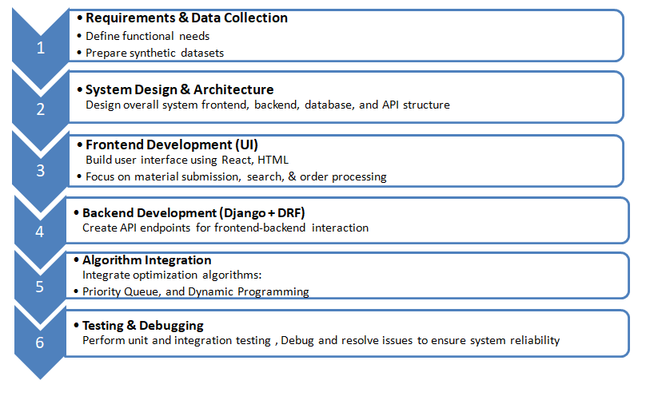
WORKFLOW

Slide 8
COMPUTATIONAL ASPECTS
ALGORITHM / DATA STRUCTURES | PURPOSE | HOW IT IS USED
HashMap (Dictionary) | Fast lookups for key-value pairs. | Quick access to material prices, plant data, and order status.
Array / List | Stores collections of data | Stores materials, plants, and orders for easy iteration and display
Priority Queue (heap) | Handle prioritized data. | Ensuring that high-priority orders are processed first
RBAC (Role-Based Access Control) | Control access based on user roles. | Determines which part of the system a user can access based on their role.
7

Slide 9
COMPUTATIONAL ASPECTS
ALGORITHM / DATA STRUCTURES | PURPOSE | HOW IT IS USED
ACL (Access Control Lists) | Fine-grained access control. | Works with RBAC to control permissions.
Multiplication Algorithm | Simple calculations. | Used to calculate total prices for orders.
Price optimization | Dynamic programming table | Tracks price adjustments
8

Slide 10
REFERENCES
[1] https://www.mdpi.com/2071-1050/14/1/480
[2]https://www.industries.veeva.com/in-the-news/cloud-computing-in-the-circular-economy-era?
[3]https://www.sciencedirect.com/science/article/abs/pii/S0959652620343845?casa_token=f47AqiUuKUsAAAAA:m9nBe4bzWiIcv2xFUr-oDcSyyL2DGrGRc1ISmNViHGERYmI71NGm85vIA9pfum-wlmquvc_aNGU
[4] https://www.sciencedirect.com/science/article/pii/S0956053X20307091
11

Slide 11

THANK YOU!

